Slide 1

Anomaly Detection
Notes:
Welcome to the introduction to big data apps and Appcenter.
Today, we’ll cover relevant information pertaining to the launch scheduled this month. This is intended to be sales training/introduction and we will not drill into technical content. R&D is developing KTS (mid Feb) that will cover the details of AppCenter.
Been working with the field organization to refine the messages and to build a program that helps you sell more Aster.

Slide 2
Agenda
Anomaly detection Introduction
Different algorithms in Anomaly detection in un-supervised learning space
Practical - Implementation of Anomaly detection
Objective –
Brief overview of algorithms used, for in detail functionality please check out reference links
Go through on implementation in Jupiter lab

Slide 3
What is Anomaly Detection?
Difference between outlier and anomalies?
Definition of Outlier and Anomalies
Example by plot
The terms are largely used in an interchangeable way. "Outlier" refers to something lying outside the norm - so it is "anomalous".
An outlier is far away data point that’s far away from the mean or median in a distribution. It may be unusual but still within realm of reality. An anomaly is illegitimate data point that is genereated from a different process than whatever generated rest of the data.
But I have the impression that "outlier" is usually used for very rare observations. In statistics, on a normal distribution, you would consider three sigma to be outliers.
When we talk about outliers, we typically mean an unusual data point in the data used to fit our model, where as an anomaly is usually meant as an unusual data point in a dataset outside of the data used to fit our model.

Slide 4
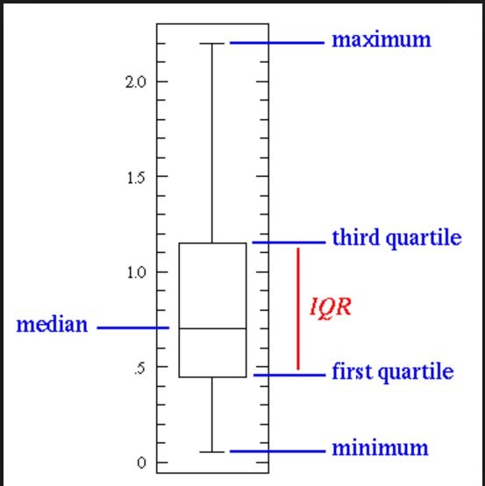
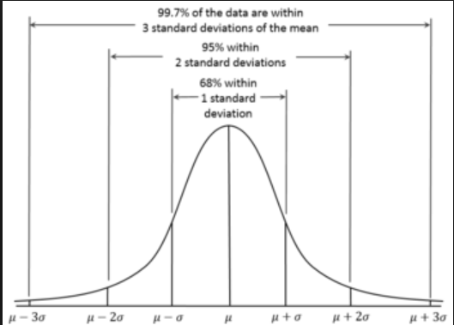
What is Anomaly Detection?
Difference between outlier and anomalies?
Definition of Outlier and Anomalies
Example by plot – Good for uni-variate data
Normal Distribution and Box plot

Slide 5
Major Techniques – Unsupervised Anomalies detection
One Class SVM
Isolation Forest
Auto encoder
Box plot outliers
Histogram comparison
DBscan (Density based clustering as opposed to Distance based like Euclidean Distance)
Kalman Filter

Slide 6
Why Threshold? Cant use - Precision and Recall
Precision – Out of 100 data points how many where predicted as Anomalies correctly.
So if we predicted 20 as anomalies and out of 20, 15 are actually anomalies then your precision is 15/20 = .75
Recall – Out of 100, lets say 22 are anomalies
So if we predicted 20 as anomalies and out of 20, 15 are actually anomalies then your recall is 15/22 = .68
If we predicted all 100 as anomalies then your recall will be 100% but Precision will be 15/100 = .15
Precision is "how useful the search results are", and recall is "how complete the results are".

Slide 7
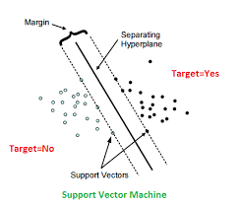
One class SVM
Basically separates all the data points from the origin (in feature space F) and maximizes the distance from this hyperplane to the origin. This results in a binary function which captures regions in the input space where the probability density of the data lives. Thus the function returns +1 in a “small” region (capturing the training data points) and −1 elsewhere.

Slide 8
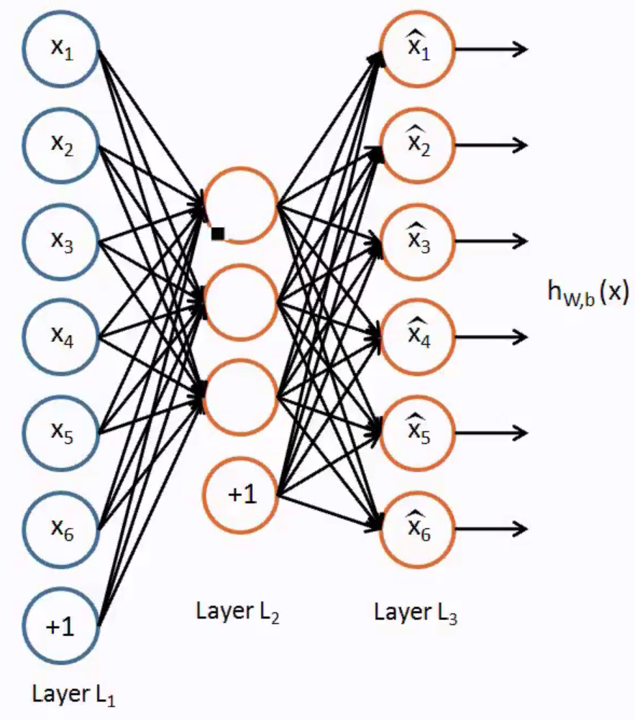
Auto-encoders
Feed forward neural network containing only one hidden layer. Basically output regenerates its inputs by encoding them first and then decoding. This way it collates (encodes) all the information in the short space (Hidden layers) in the process keeps important properties which is seen overall in the dataset and throws out unimportant ones.

Slide 9
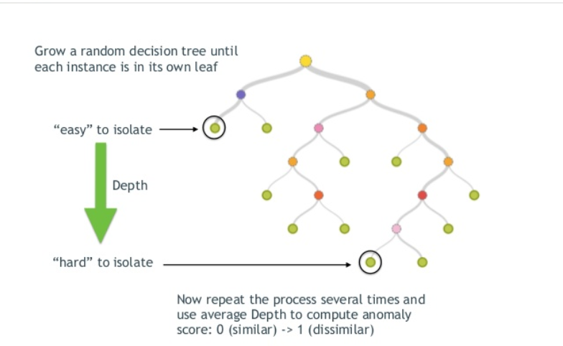
Isolation Forest
The Isolation Forest algorithm isolates observations by randomly selecting a feature and then randomly selecting a split value between the maximum and minimum values of the selected feature. The logic arguments goes: isolating anomaly observations is easier as only a few conditions are needed to separate those cases from the normal observations. On the other hand, isolating normal observations require more conditions. Therefore, an anomaly score can be calculated as the number of conditions required to separate a given observation.

Slide 10
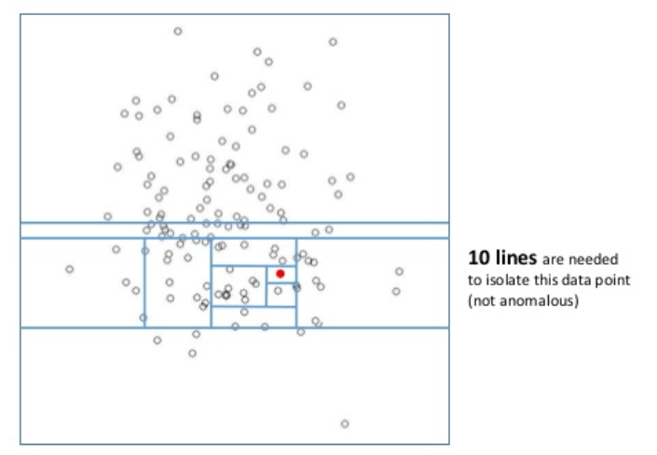
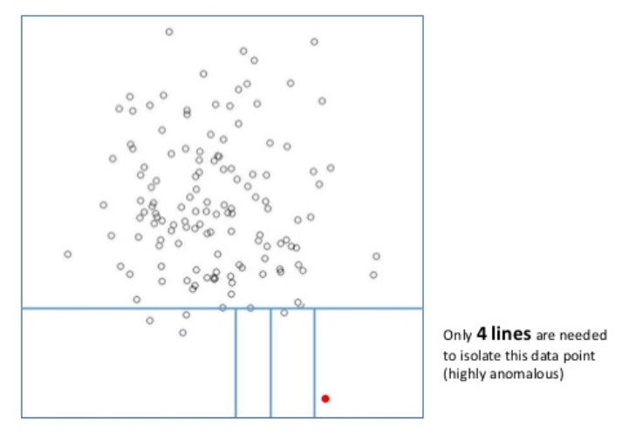
Isolation Forest

Slide 11
Applications
Machine failure/abnormality detection
Security threat / Virus detection
Invalid transaction/Fraud detection

Slide 12
Reference links
Auto encoders: https://www.youtube.com/watch?v=vfnxKO2rMq4
SVM: https://www.youtube.com/watch?v=mTyT-oHoivA
Isolation Forest:

